Slide 1
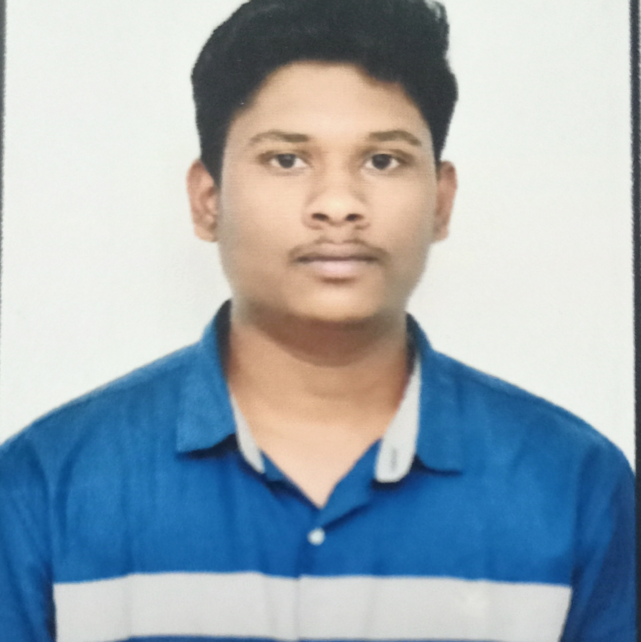


Hemanth Kumar Yadav
Analyst/Software Engineer
BACHELOR OF ENGINEERING
Electronics and communication
2017-2021
Skills C#
DotNet core
MS-SQL
C++
Database
MS SQL Server 2014
Web Technologies
HTML
CSS
AddOns
Github
Postman
Additional skills
Leadership Qualities
Quick Learner
Team Management
BANGALORE
hemanth-kumar.yadav@capgemini.com
+91 9606309024
A4
Eager to work in a team of dedicated people and serve a key role in the enhancement and development of the project.
Software Engineer who is Strong in design and integration with intuitive problem-solving skills. Passionate about implementing and launching new projects.
Ready to learn new technologies and implement them to further improve my knowledge.
Hands on experience in C#, ASP.NET MVC Framework, HTML, CSS and SQL Server.
Medicine Management System :
Completed end to end case study of Medicine Management System using entity framework along with Postman.
Microsoft Azure Fundementals Certificate :
AZ-900 Certified.
Additional Details
Excellent Communication Skills
Team Player
Check out my work on GitHub Profile

